Slide 1
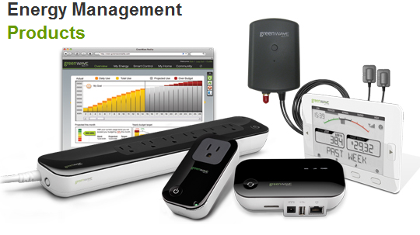
EMS Team Meeting
Johnny Nguyen
Camilo Aguilar
Upa Sundaram
Charles Lam
May 15, 2013

Slide 2
Milestones
Real time, wireless display.
Able to display 2 meters (but with interference problems).
Improving the code
More devices, more waveform features
Practiced Demo/Presentation Skills

Slide 3
Current Progress
Trouble with wireless
Found that sending and receiving addresses did not mach
11 waveform features in code
However, consumed too much memory. Code takes over 256 KB of flash provided in evaluation board.
Still unable to find amount of memory used by code.

Slide 4
Future Tasks
Assist/Train up new members
Find DSP chips for quicker, real time solution.
Solve memory problem

